Slide 1
Mining Yelp Data:
Creating the Best For-Student Restaurant
Alan Fernandez, Guangxin Hu, Luke Buquicchio, Ruonan Feng, Wenhan Ji

Slide 2

Use Yelp Restaurant Review Data to Identify the Key Characteristics of Restaurants That Serve Students.
Notes:
Our Approach:
We will use the Yelp Dataset to mine restaurant reviews.

Slide 3





Interview
Outdoor Seating
Attire
Alcohol
Ratings
Noisy

Slide 4

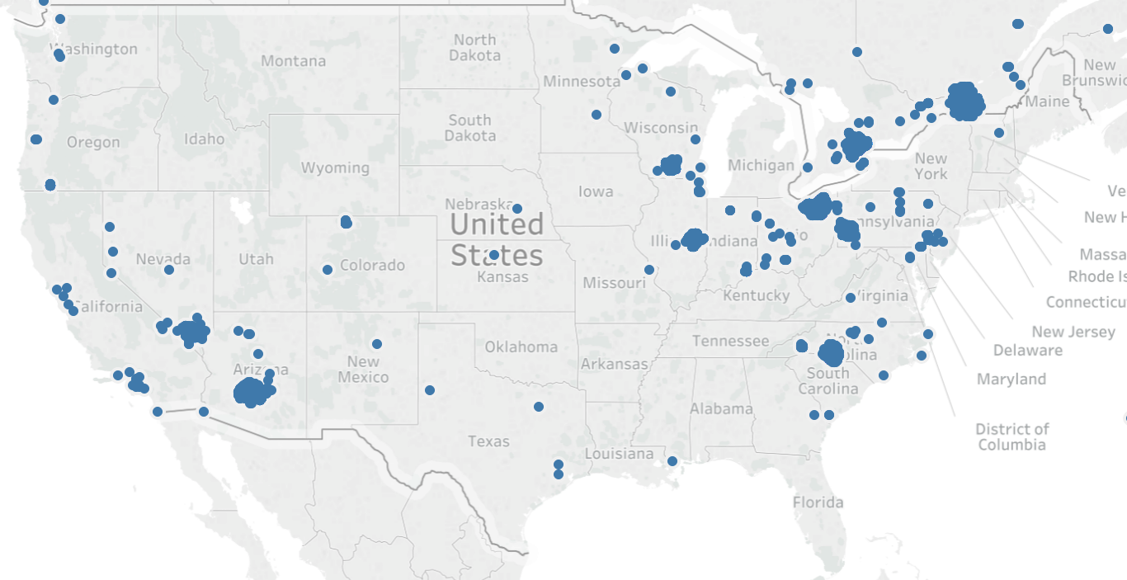




Slide 5
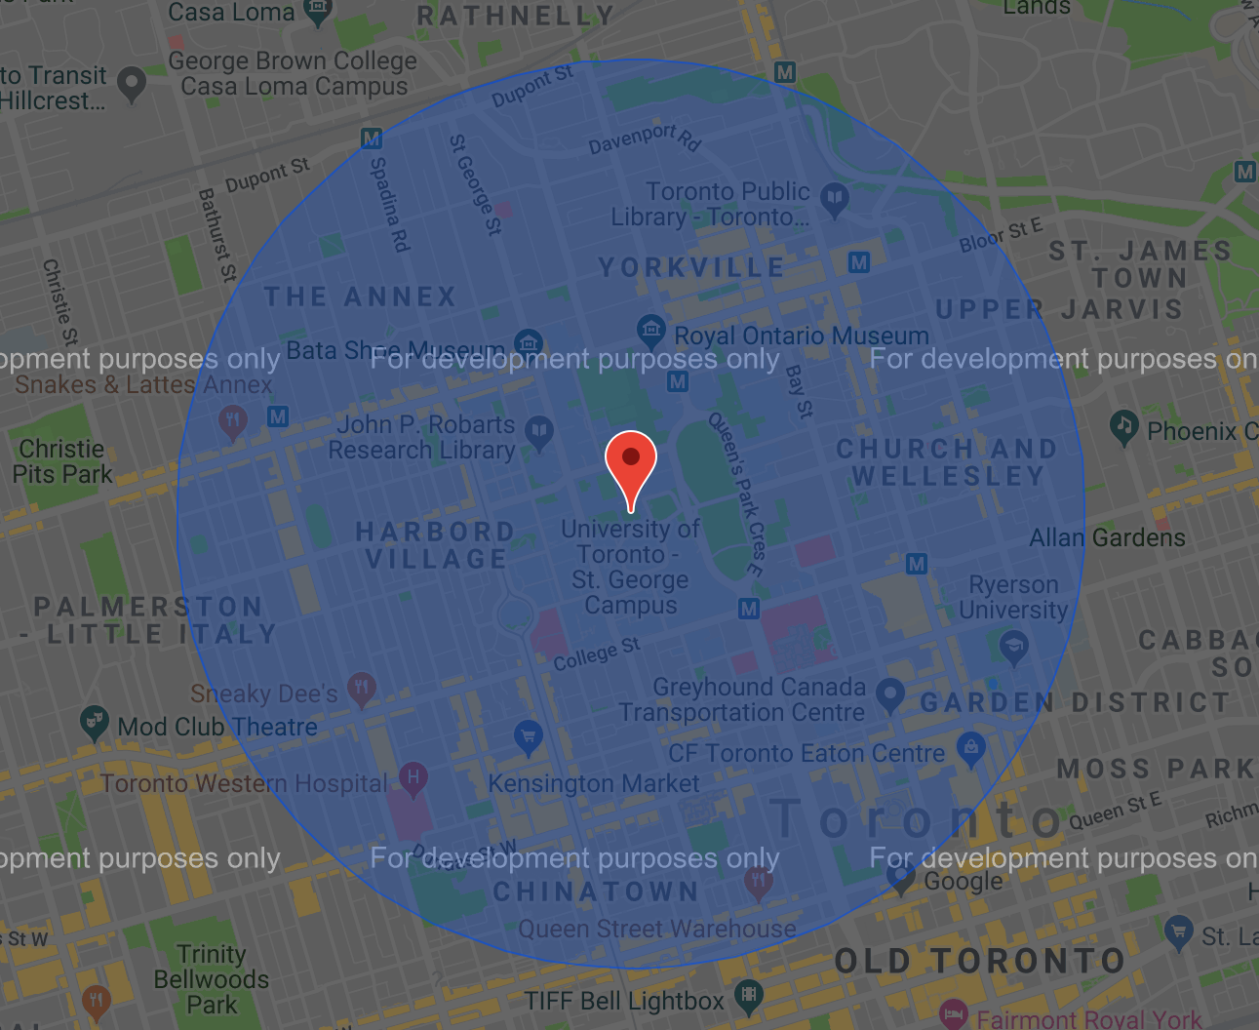
Notes:
Clean Data
Limit data to restaurant category and within a 5 mile radius from the university campus.
Use geopy to calculate distance between university and business.

Slide 6
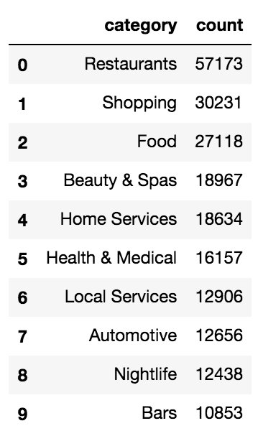
Most Popular Business Category

Slide 7
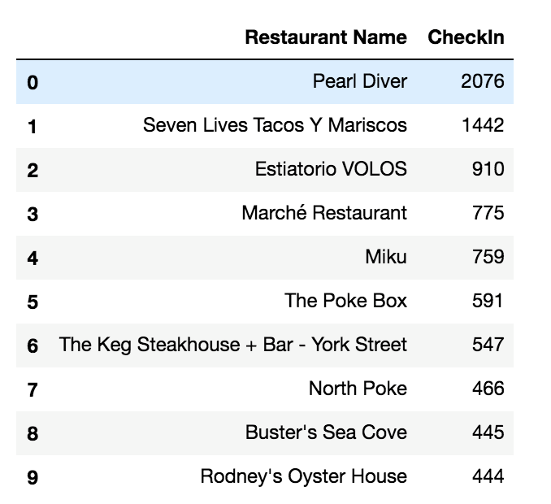
Most Popular Restaurants Around U of Toronto

Slide 8
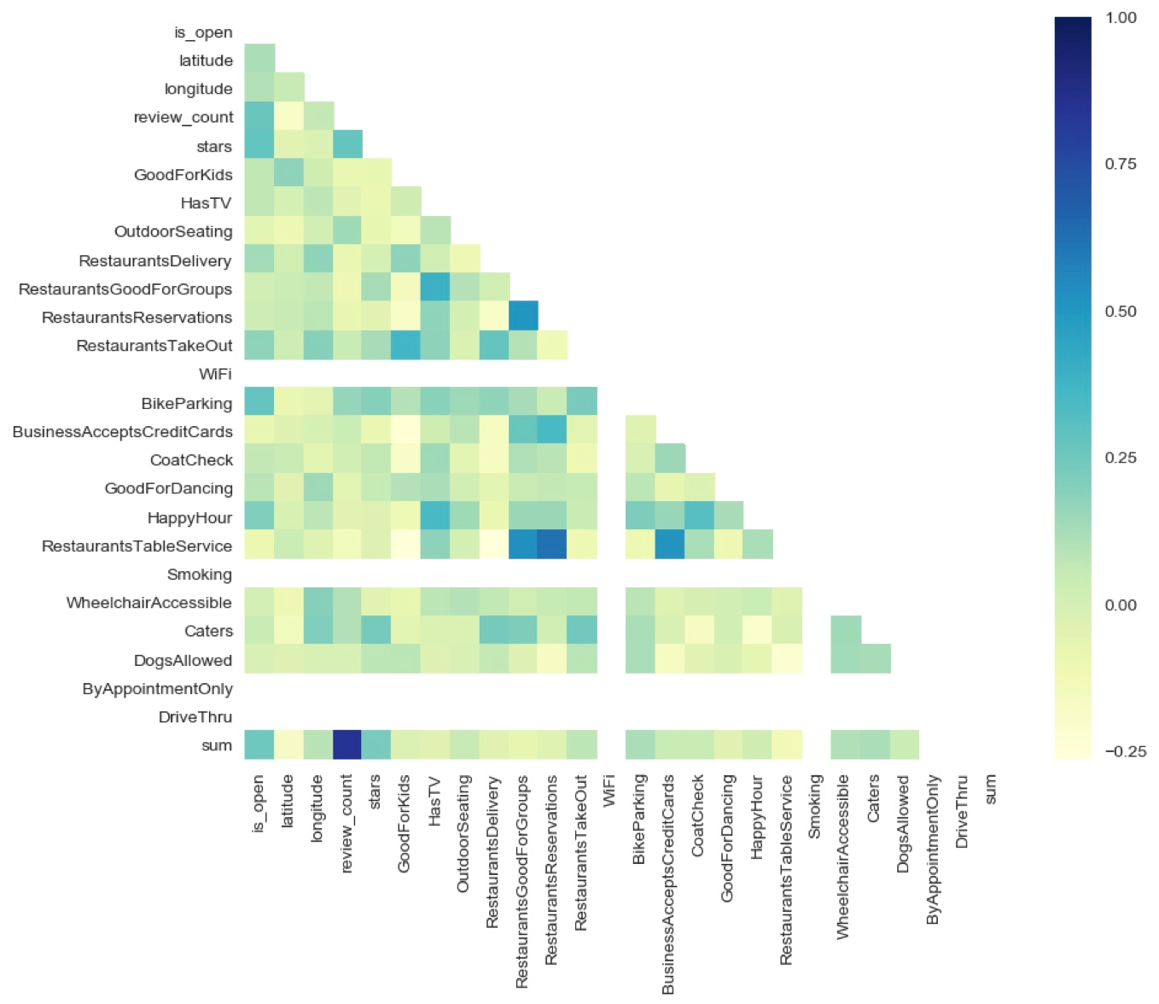
Notes:
Data cleaning and learning about our data
Each string was converted into integer values

Slide 9
Our Model: Gradient Boosting
Ensemble of decision trees (works with regression or classification)
Iteratively add new decision trees based on the mistakes of the previous model
The “mistakes” of the previous trees are with respect to a loss function
Commonly Mean Squared Error
Optimizes loss function the same way as gradient descent
Notes:
It’s a little hard to explain in one minute, but here it goes.
http://www.cse.chalmers.se/~richajo/dit865/files/gb_explainer.pdf

Slide 10
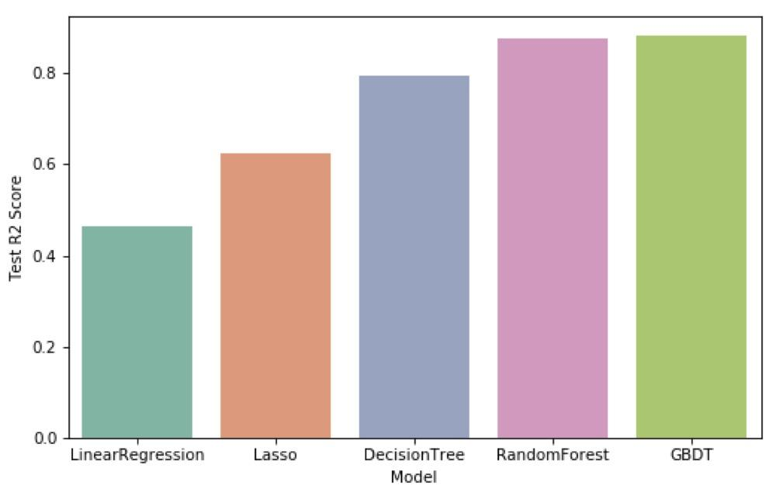
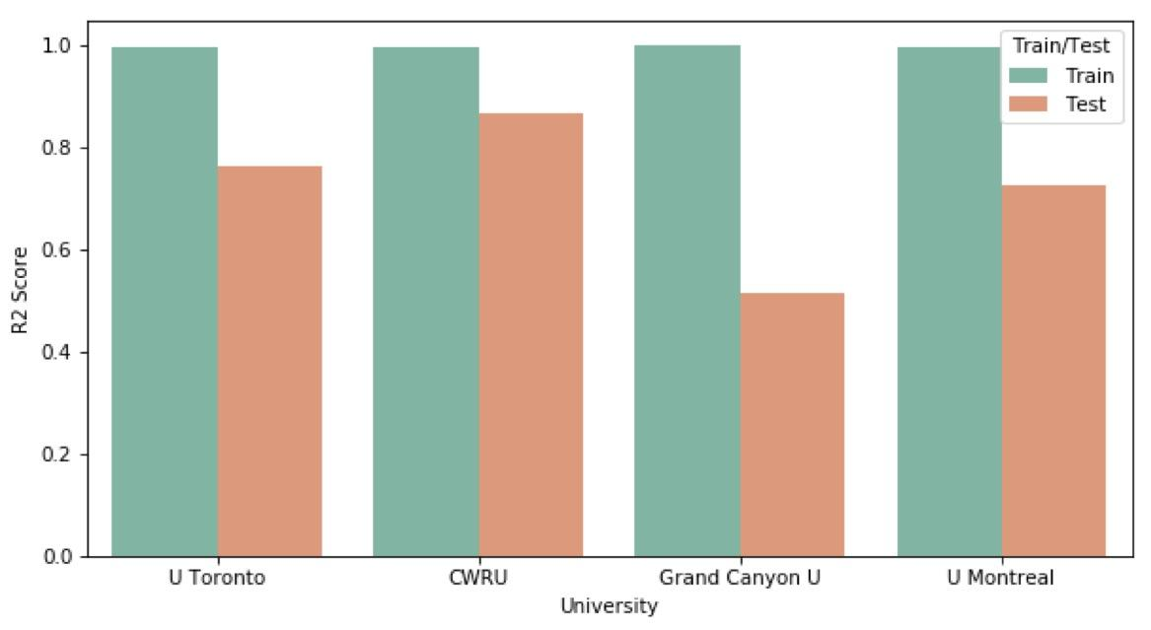
Model Accuracy

Slide 11
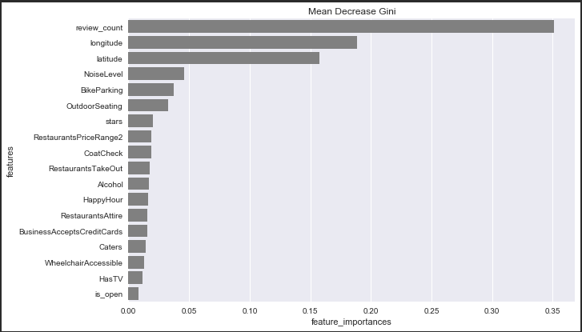
Review Count | Distance | Noise Level | Bike Parking | Outdoor Seating | Stars
Notes:
Results:
We plotted the importance of the features and we discovered the following top 6 predictors…
A sanity check confirms our expectations: The most popular

Slide 12
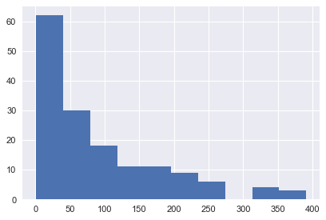
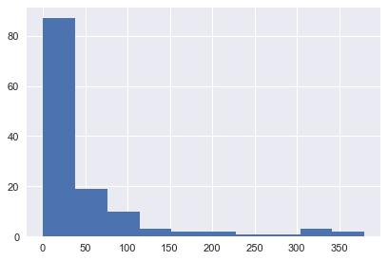
Number of Restaurants vs Check-ins

Slide 13
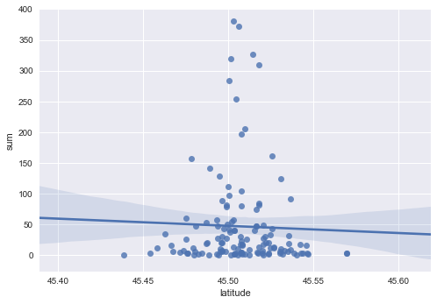
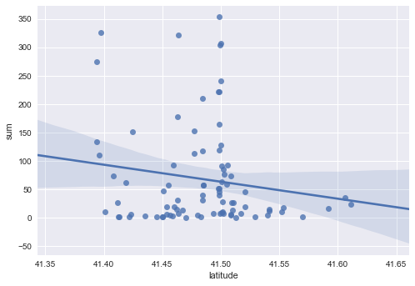
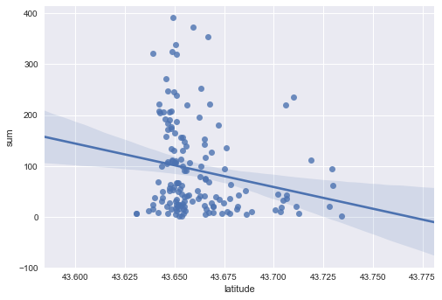
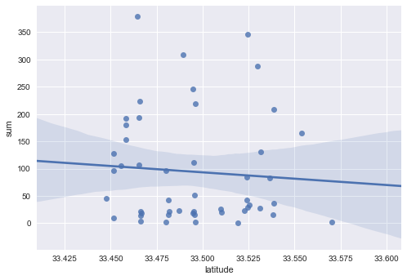

Slide 14
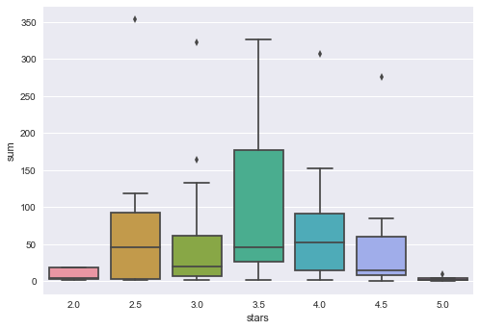
Star Rating vs. Total Check-ins

Slide 15
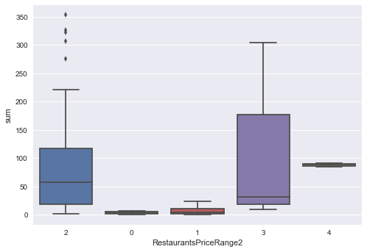
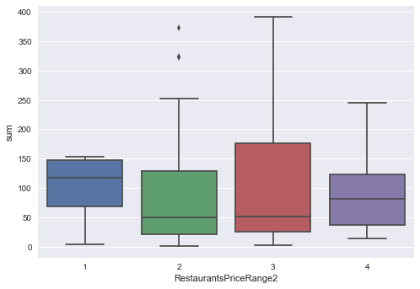
Notes:
Reina

Slide 16
Price Level
Stars
Noise Level
Distance
Bike Racks
Notes:
Alan

Slide 17
Thank you!

